Slide 1
Project Chimera Design
By: William Estep
Brandon ward
Joshua stanton

Slide 2


Problem Definition
General media is flooded with information and examining all the information on a casual basis is an impossible task.
Current search engines are either too broad or too specific for many people who have a general idea what they want, but nothing concrete.
Specifically, almost everyone today is searching for forms of entertainment and an incredible amount of differing varieties of entertainment are being produced.
For the regular person, navigating this massive pile of media is more work then they are willing to deal with.

Slide 3
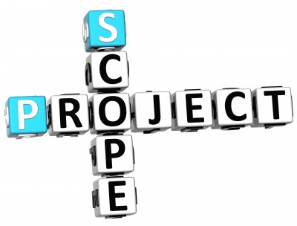
Project Scope
Project Chimera is intended as an android mobile application.
The main functional pieces of Project Chimera will be based on the ability to rapidly search a database of multiple types of entertainment media and provide suggestions for the user.
Users will be able to login and have their own preferences and other pieces of information to increase the efficiency of the database search.
The majority of the data will be stored on a server to be accessed when the application is running.

Slide 4
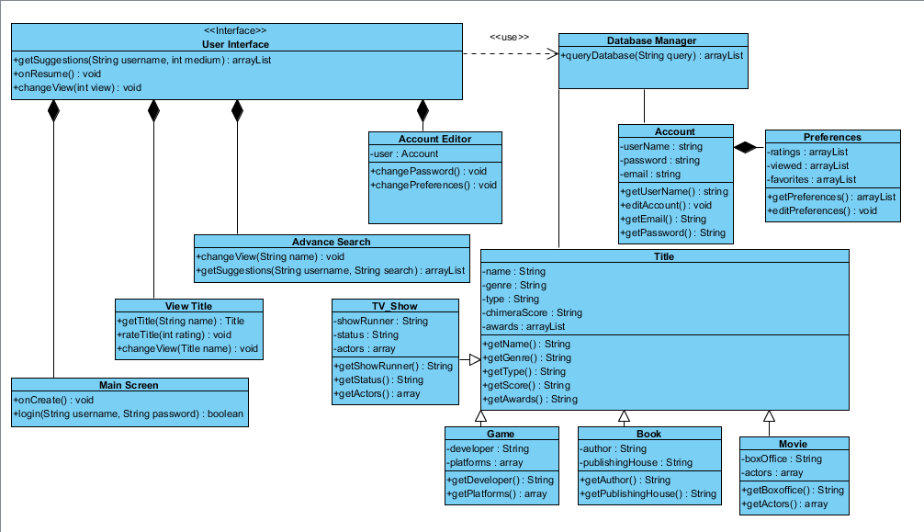
Class Diagram

Slide 5
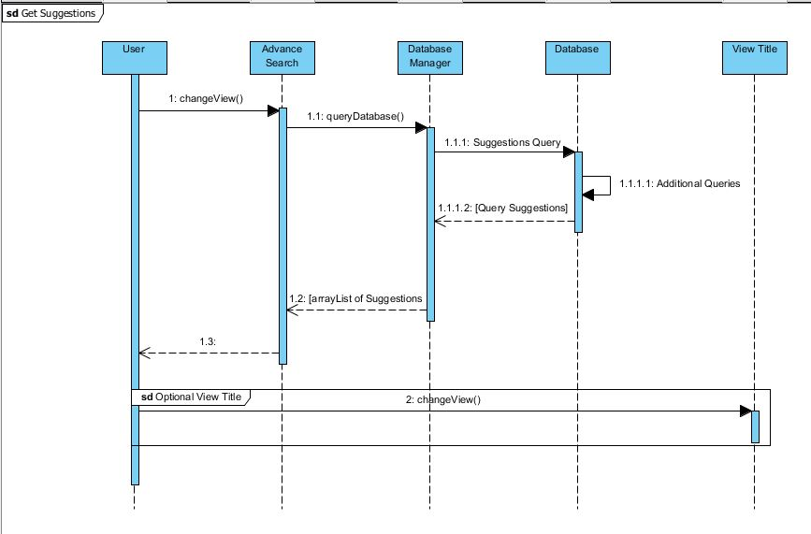
Sequence Diagrams: Get Suggestions

Slide 6
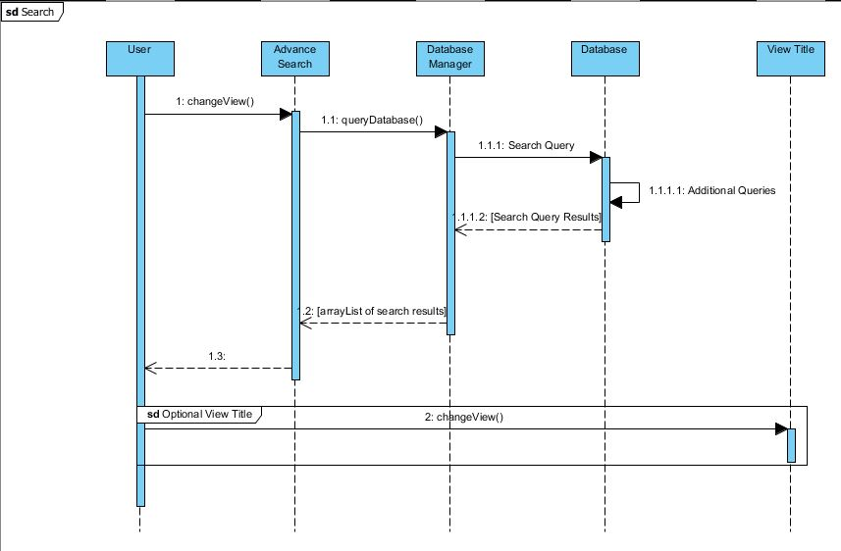
Sequence Diagrams: Search

Slide 7
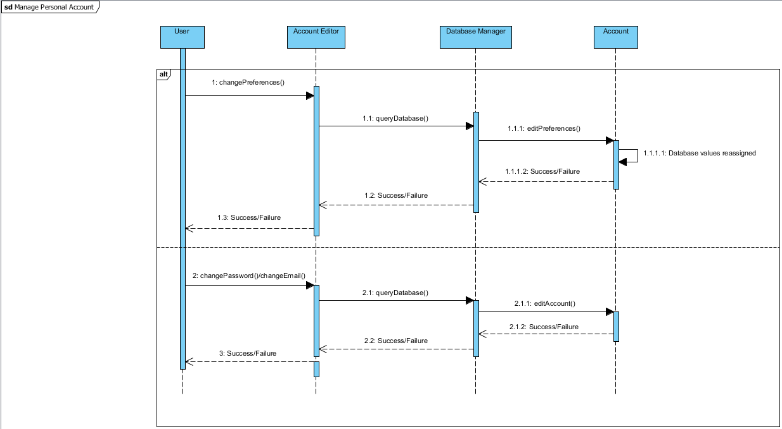
Sequence Diagrams: Manage Account

Slide 8
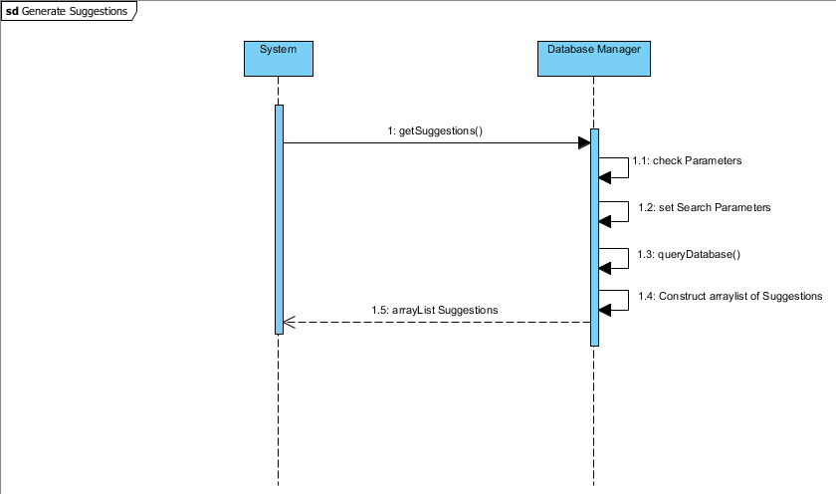
Sequence Diagrams: Generate Suggestions

Slide 9
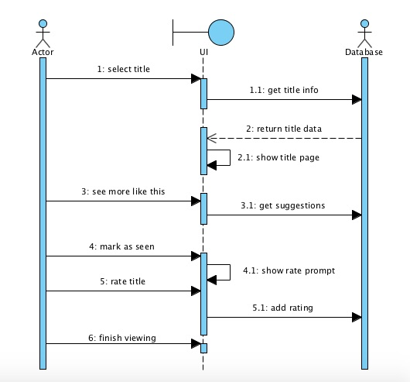
Sequence Diagrams: View Title

Slide 10
Major Changes
Since the requirements portions of the project we have yet to discover any issues that have resulted in major shifts in the project’s goals or focus.
We expect these changes, if any, will arise during the implementation and testing phase due to possible optimization issues.

Slide 11
Team Summary

